Slide 1

Department of Computer Science and Engineer - Data Science
AUTOMATED DOCUMENT PROCESSING WITH AWS TEXTRACT (Extract text and data from scanned documents using AWS Textract)
Batch No. 01
1. K.Avinash 228R1A67F6 2. P.Priyatham 238R5A6716
3. U.Uday Kiran 228R1A67J7
4. D.Nithish 228R1A67D8
Under the Guidance of
Dr.M.Laxmaiah
Head Of Department, Department of Data Science

Slide 2
OUTLINE
INTRODUCTION
OBJECTIVES
PROBLEM IDENTIFICATION AREA
LITERATURE SURVEY
FURTHER DEVELOPMENT OF RESEARCH WORK
BLOCK DIAGRAM
EXPECTED RESULTS

Slide 3
INTRODUCTION
Manual document processing (reading, extracting, and entering data from scanned documents) is time-consuming and error-prone.
AWS Textract is a machine learning service that automates extraction of text, forms, tables, and key-value pairs from scanned documents, improving efficiency and accuracy.
This project explores the use of AWS Textract to automate document workflows and reduce human effort.

Slide 4
OBJECTIVES
To automate extraction of structured and unstructured data from scanned documents.
To reduce manual data entry time and errors.
To store extracted data into databases for further processing.
To demonstrate integration of AWS cloud services (Textract, S3, Lambda, DynamoDB).
To develop a scalable, cloud-based document processing system.

Slide 5
PROBLEM IDENTIFICATION AREAS
Invoice Processing:
Extracting vendor name, invoice number, dates, line items, and totals for accounting automation.
Form Digitization:
Extracting data from government or business forms like applications, registration forms, or surveys.
ID Document Processing:
Reading passport, driver’s license, or Aadhaar card data for verification purposes.
Healthcare Records:
Extracting structured data from patient forms, prescriptions, and insurance claims.

Slide 6
LITERATURE SURVEY
S.No | Title / Tool | Description | Limitations
1 | Tesseract OCR | Open-source tool that extracts plain text from scanned documents. | Cannot detect forms, tables, or complex document structures.
2 | Deep Learning (CNN + RNN) | Machine Learning models trained to detect text areas and understand document layouts. | Requires a lot of labeled training data and large computational power.
3 | AWS Textract | Cloud-based AI service by Amazon that extracts text, forms, and tables automatically from documents. | Dependent on AWS services; costs may increase with heavy usage.

Slide 7
S.No | Title / Tool | Description | Limitations
4 | Machine Reading Comprehension (MRC) Research | Research area focusing on machines reading and understanding documents like humans. | Still an evolving field, complex documents are harder to handle.
5 | Manual Data Entry | Humans manually entering information from documents. | Time-consuming, costly, and prone to human errors.

Slide 8
FURTHER DEVELOPMENT OF RESEARCH WORK
NLP Integration
After text extraction, use Natural Language Processing to find important details like names, dates, and amounts.
Document Classification
Automatically detect document types (e.g., invoice, receipt, form) based on the extracted data.
Web Application Development
Build a simple website where users can upload documents and view extracted information easily.

Slide 9
4.Database Storage and Search Store extracted data in a database and allow users to search by keywords like name, date, or invoice number. 5.Automation Using AWS Lambda Automatically process documents once they are uploaded, without manual work. 6.Error Handling Detect issues like blurry images or wrong formats and give user-friendly error messages.

Slide 10
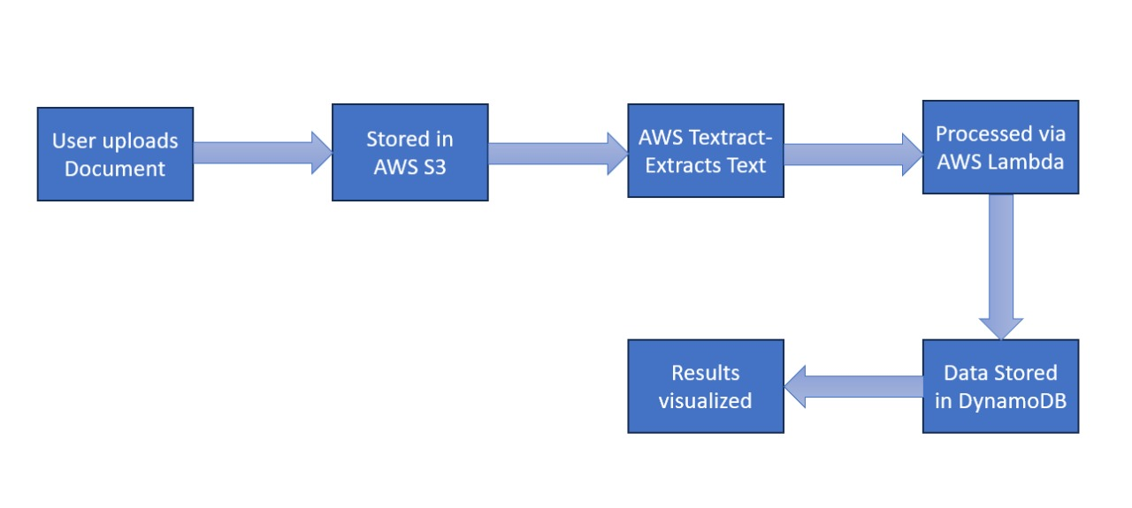
BLOCK DIAGRAM

Slide 11
EXPECTED RESULTS
Accurate Extraction
AWS Textract will correctly extract text, tables, and form data from scanned documents.
Reduced Manual Work
Less human effort and fewer typing errors during data entry.
Faster Document Processing
Documents processed within seconds compared to manual methods.
Organized Data Storage
Extracted data will be neatly saved into a database for easy access.

Slide 12
THANK YOU
ANY QUERIES/SUGGESTIONS?

